Slide 1
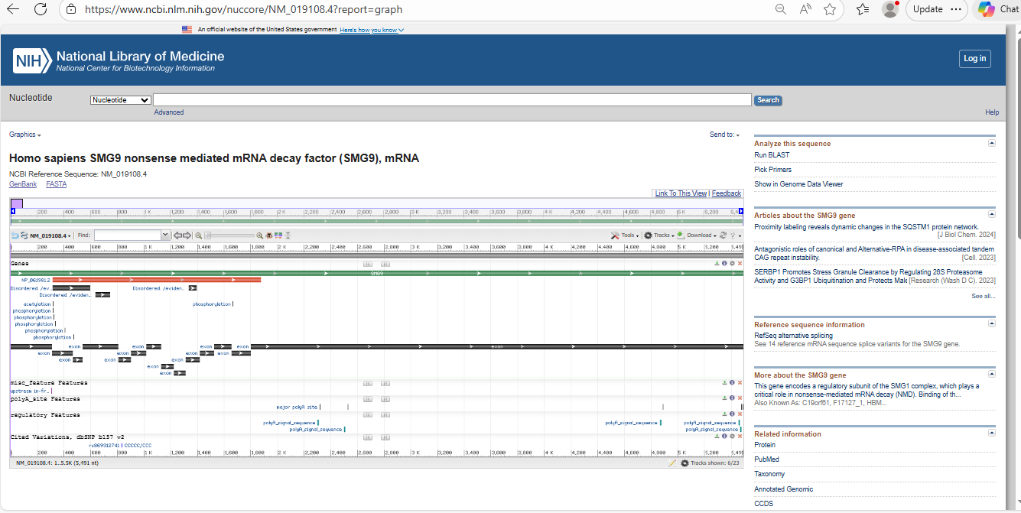
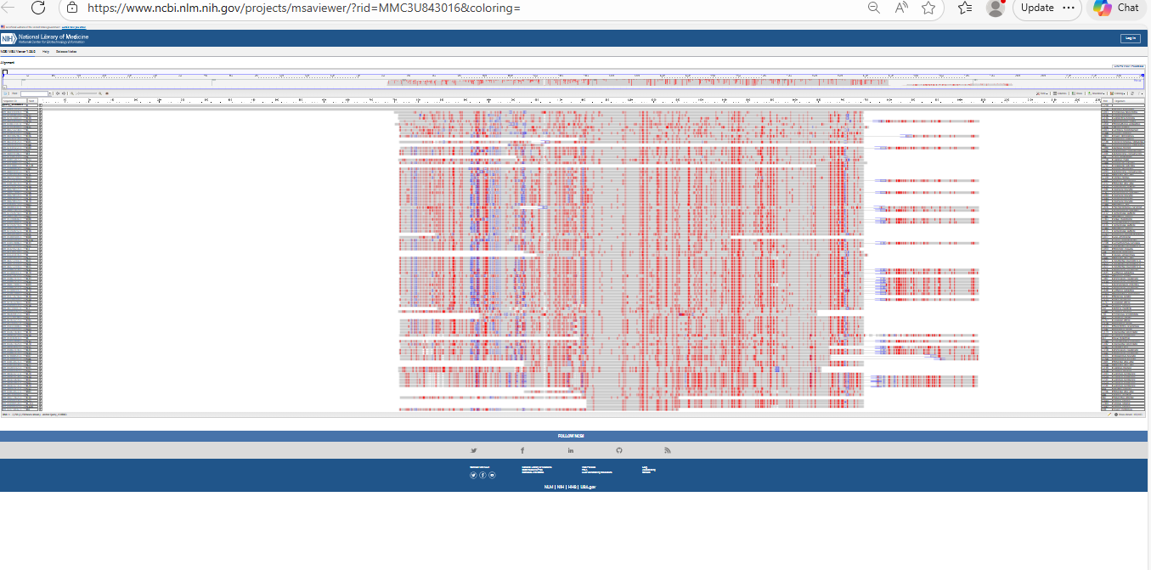
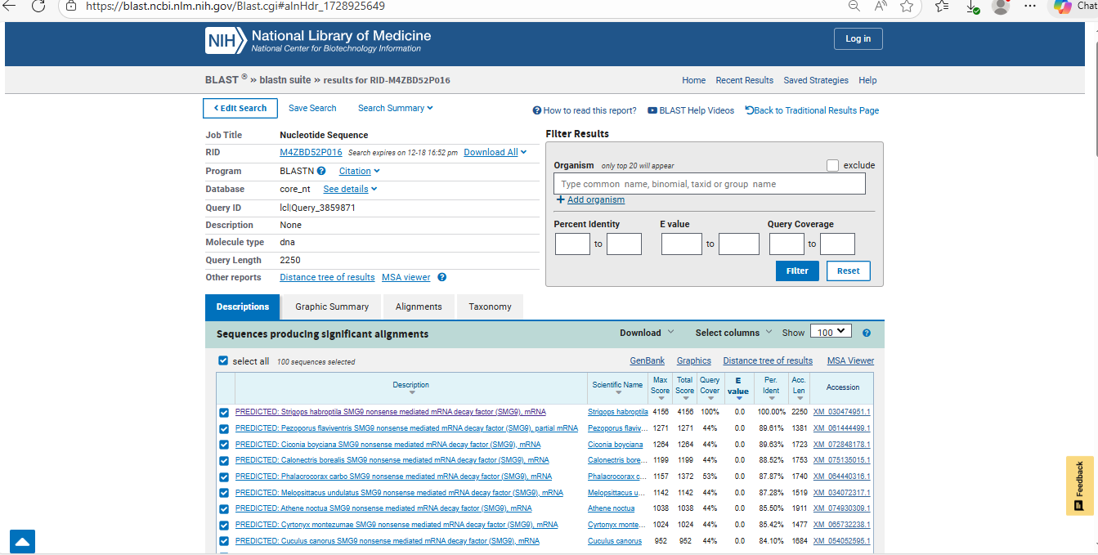
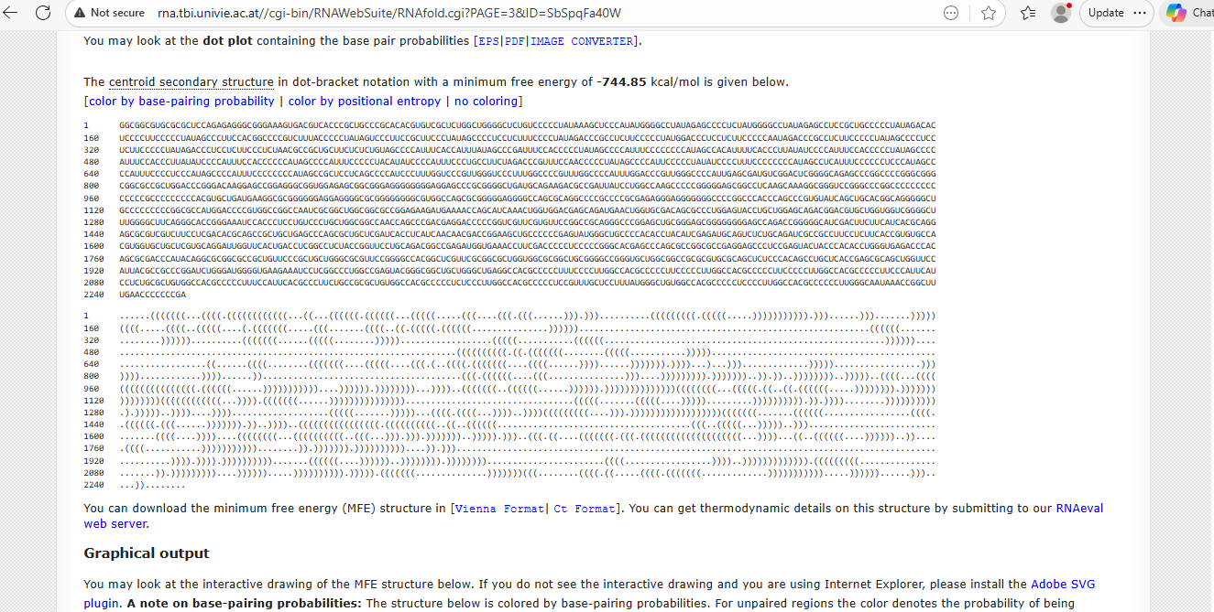
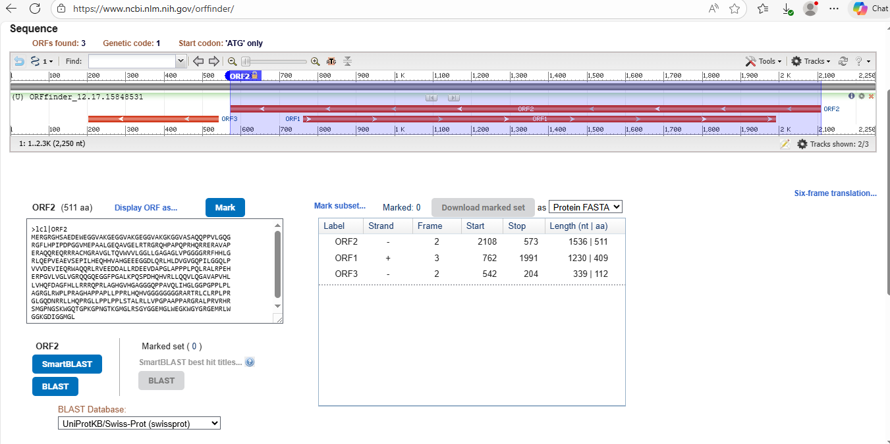
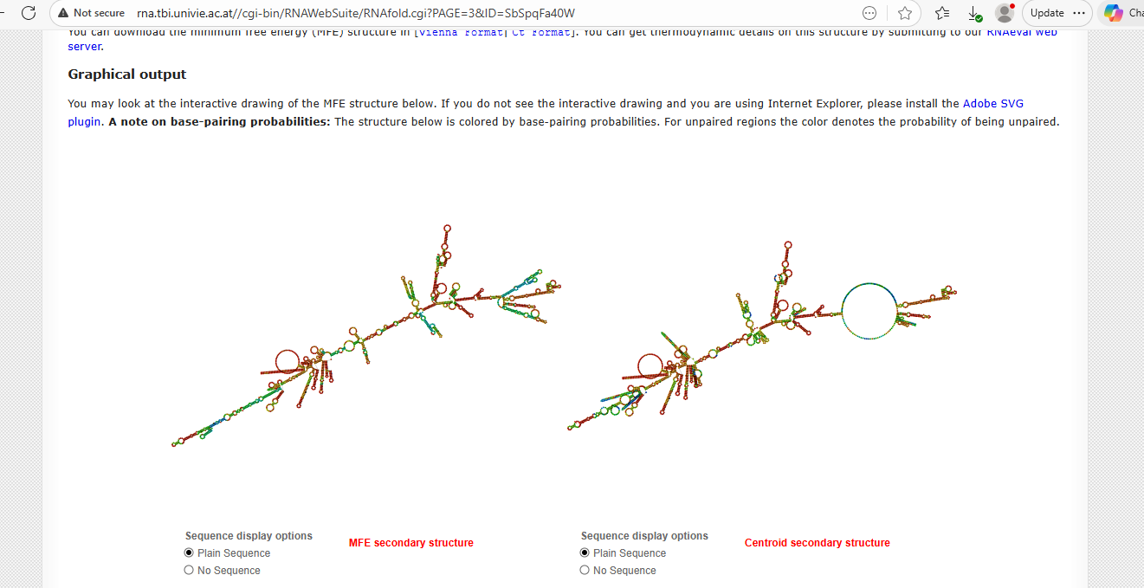
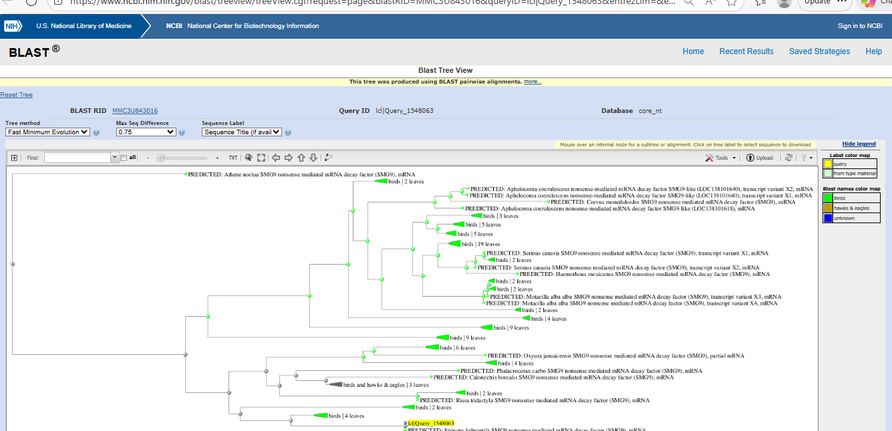
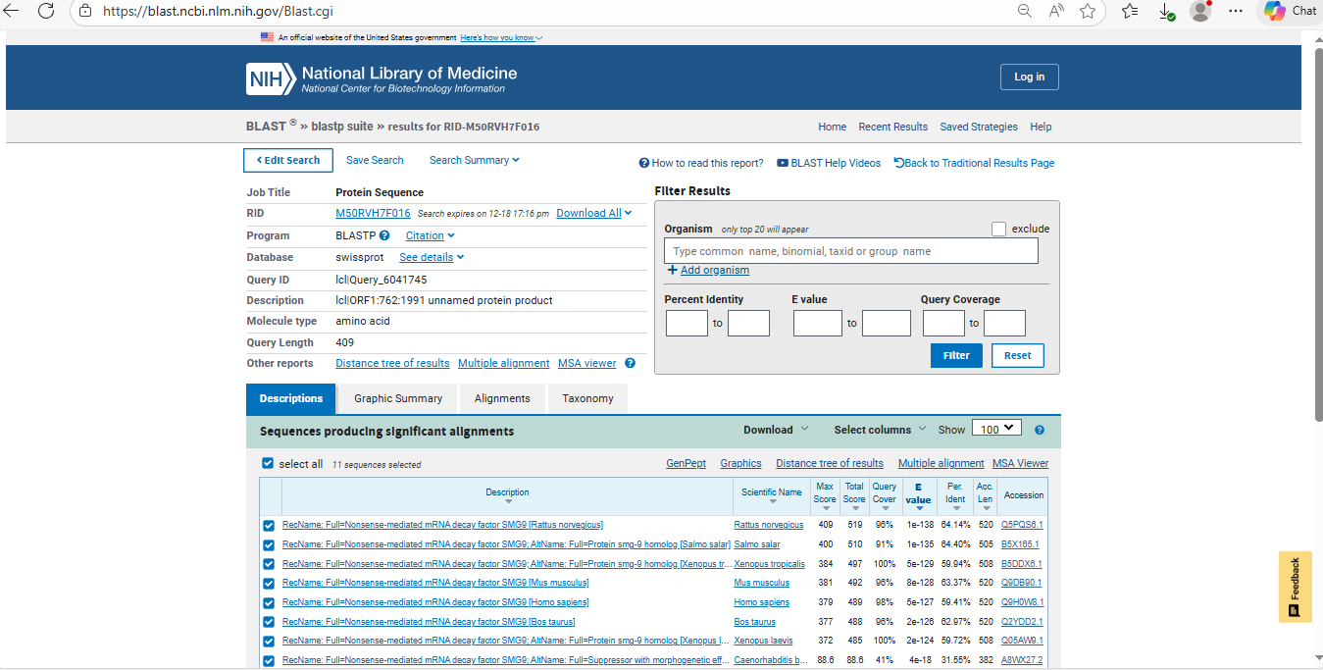

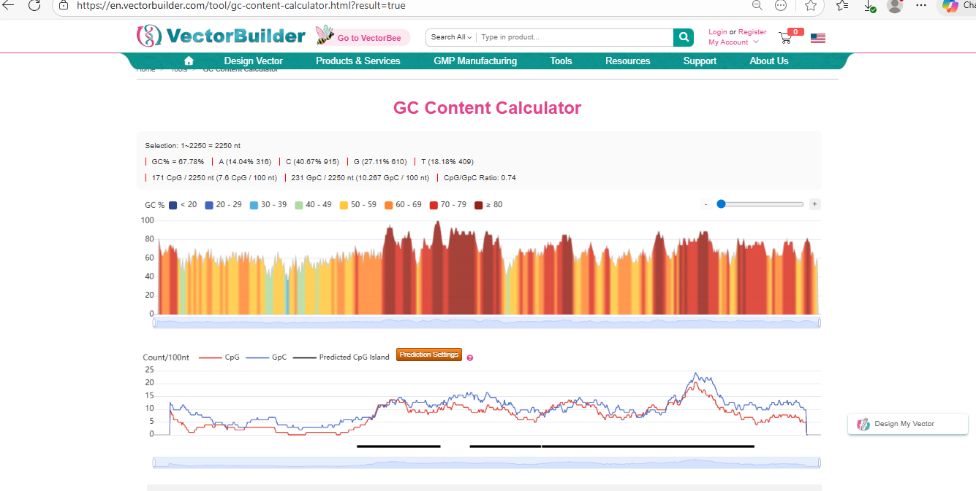
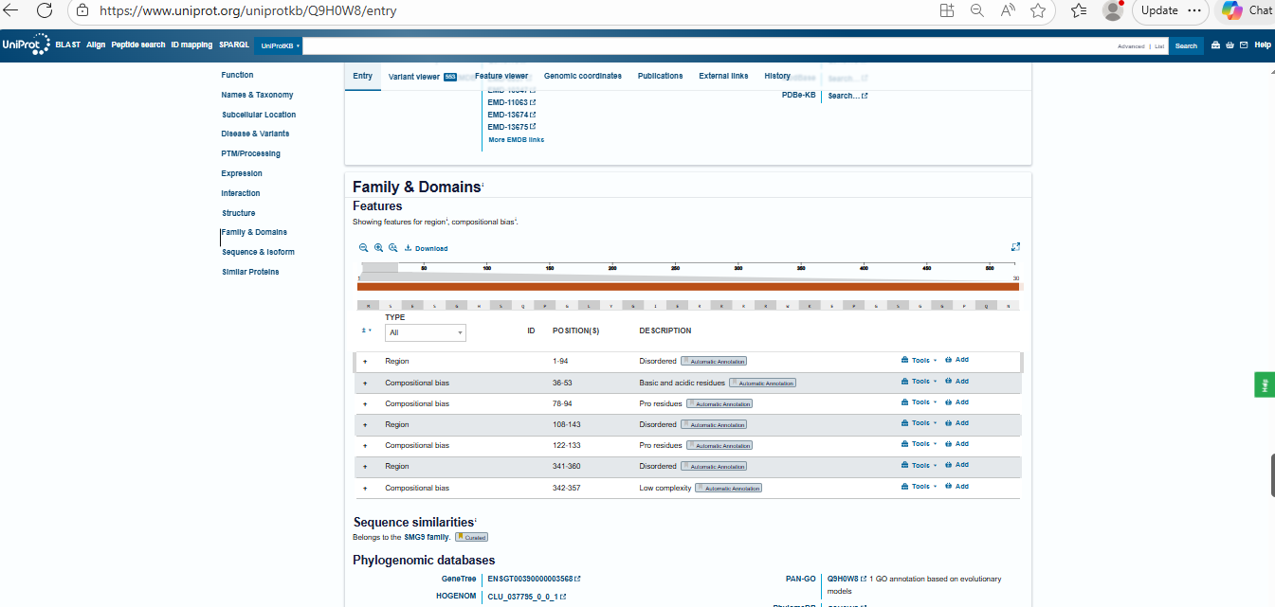
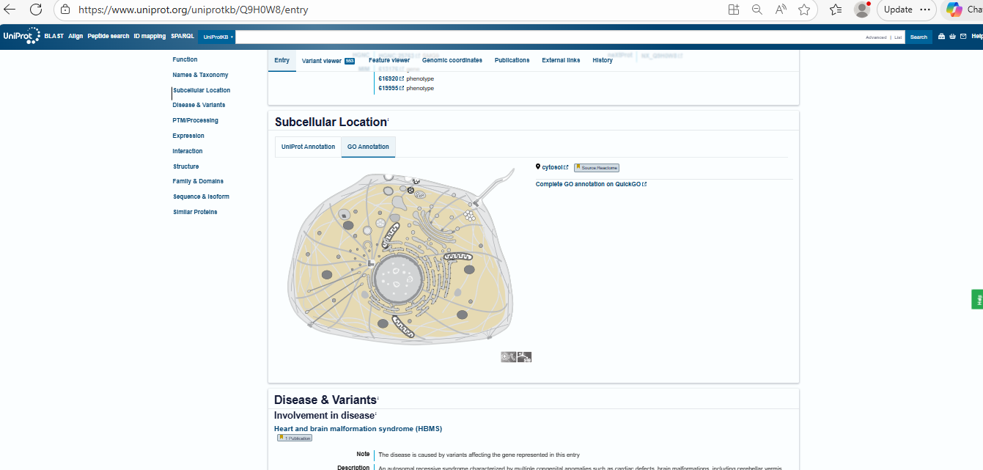
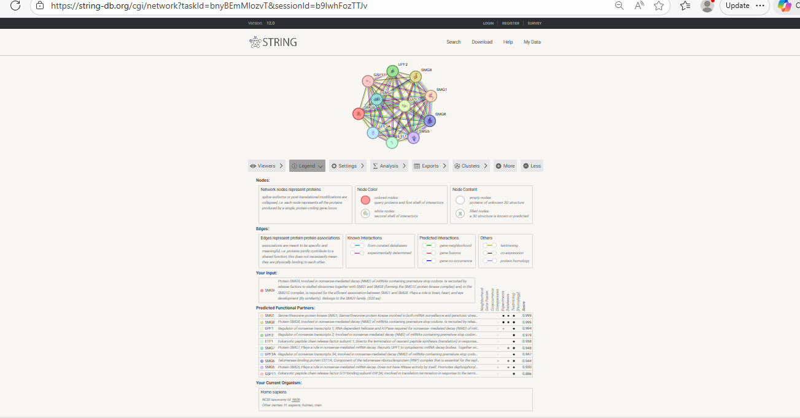
Computational analysis of the nonsense-mediated mRNA decay factor SMG9
Eraj Aijaz I Department of Biochemistry I Bioinformatics Project
Polyadenylation Signal Identification
Canonical signal
AAUAAA
Observed
Non-canonical variants detected:
  AUUAAA
  AAUAUA
Located upstream of AU-rich 3′ end
Conclusion:
✔ Functional non-canonical polyA signals present, common in GC-rich genes.
Introduction
RNA Analysis
Phylogenetic
Analysis
BLASTn analysis of the nucleotide sequence against the NCBI database identified the sequence as the nonsense-mediated mRNA decay factor SMG9. The top hit showed 100% query coverage, 100% identity, and an E-value of 0.0, confirming the identity of the gene.
The 5′ UTR is likely regulatory, influencing ribosome scanning and translation efficiency rather than blocking translation.
Functional but moderate-strength Kozak sequence
Functional non-canonical polyA signals present, common in GC-rich genes.
RNAfold Structure
RNAfold analysis predicts a highly stable mRNA secondary structure with extensive stem-loop formations, particularly within the GC-rich 5′ untranslated region. The strongly negative minimum free energy indicates thermodynamic stability and resistance to degradation.
The phylogenetic tree was generated using NCBI BLAST Tree View based on pairwise sequence alignments of homologous SMG9 (nonsense-mediated mRNA decay factor 9) sequences from different species. The tree illustrates the evolutionary relationships among homologs by clustering sequences according to their similarity.
Closely related species, particularly avian species, cluster together in well-defined branches, indicating a high degree of sequence conservation within this taxonomic group. This suggests that the SMG9 protein has maintained a similar structure and function during avian evolution. More distant branches represent homologs from other vertebrates, reflecting gradual divergence over evolutionary time.
The query sequence (highlighted) clusters within the vertebrate clade, supporting its classification as a conserved eukaryotic protein. Overall, the tree demonstrates that SMG9 is evolutionarily conserved, consistent with its essential role in the nonsense-mediated mRNA decay (NMD) pathway, a fundamental cellular quality-control mechanism.
DNA Analysis
The longest ORF in the + strand was selected as the most likely coding region. This ORF corresponded to the region that produced high-confidence BL AST hits to SMG9 mRNA, confirming it as the true coding sequence.
Protein-level homology confirmed that the translated ORF encodes SMG9, a conserved component of the nonsense-mediated mRNA decay (NMD) pathway.
The BLASTp results validate that the identified ORF represents a true protein-coding region rather than a spurious ORF
Protein Analysis
Conclusions
GC Content Analysis
This bioinformatics analysis demonstrates that the studied protein is a highly conserved, non-enzymatic regulatory factor involved in the nonsense-mediated mRNA decay (NMD) pathway. Sequence and domain analyses revealed extensive intrinsically disordered regions, supporting a role in flexible protein–protein and RNA interactions. Subcellular localization predictions indicate a cytoplasmic and nuclear localization, consistent with its function in mRNA surveillance. Phylogenetic analysis showed strong conservation across vertebrate species, highlighting its evolutionary importance. Interaction network analysis further confirmed its integration within the core NMD machinery, emphasizing its critical role in maintaining mRNA quality control and cellular homeostasis.
Subcellular
localization
Predicted Functions
• The protein contains extensive intrinsically disordered and low-complexity regions, indicating a non-enzymatic, regulatory role rather than catalytic activity.
• Compositionally biased motifs (proline-rich and acidic/basic regions) suggest involvement in protein–protein and RNA associated interactions.
References
Protein-Protein
Interactions
UniProt Consortium. (2024). UniProt: the universal protein knowledgebase. Nucleic Acids Research, 52(D1), D735–D742.
National Center for Biotechnology Information (NCBI). (2024). Gene and BLAST databases. U.S. National Library of Medicine.
Szklarczyk, D., et al. (2023). STRING v12: protein–protein association networks. Nucleic Acids Research, 51(D1), D638–D646.
Almagro Armenteros, J. J., et al. (2017). DeepLoc: prediction of protein subcellular localization. Bioinformatics, 33(21), 3387–3395.
Horton, P., et al. (2007). WoLF PSORT: protein localization predictor. Nucleic Acids Research, 35(Web Server issue), W585–W587.
Sievers, F., et al. (2011). Clustal Omega for multiple sequence alignment. Molecular Systems Biology, 7, 539.
Localization Prediction (2 Tools)
DeepLoc 2.0 predicted the protein to be localized predominantly in the cytosol, with a secondary probability for nuclear localization. The prediction is consistent with the absence of signal peptides and transmembrane helices.
WoLF PSORT classified the protein as cytoplasmic/nuclear, based on amino acid composition, lack of organelle-targeting sequences, and enrichment of disordered regions.
Justification:
The protein lacks signal peptides, mitochondrial targeting sequences, and transmembrane domains, excluding localization to membranes or organelles such as mitochondria or chloroplasts. The presence of extensive intrinsically disordered regions supports a role in dynamic RNA surveillance and protein–protein interactions, which occur primarily in the cytoplasm and nucleus. This localization is consistent with the known function of SMG9-family proteins in the nonsense-mediated mRNA decay (NMD) pathway.
STRING network analysis reveals that the protein is strongly associated with core components of the nonsense-mediated mRNA decay (NMD) pathway, including SMG1, SMG5, SMG6, SMG7, UPF1, UPF2, and UPF3. Gene Ontology (GO) enrichment indicates significant involvement in mRNA surveillance, RNA metabolic processes, and post-transcriptional gene regulation. These interactions highlight the protein’s role as a regulatory factor coordinating the recognition and degradation of aberrant mRNAs containing premature stop codons. The dense connectivity within the NMD complex suggests functional cooperation rather than enzymatic activity, emphasizing its importance in maintaining mRNA quality control, transcriptome integrity, and cellular homeostasis.

